Slide 1

Trace and Gigit
Android Application

Slide 2




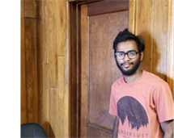

Team Members
Nandini Yadav Janga Subrahmanya Sai Bharadwaj Gandrakota Nikitha Lakmarapu
Deepak Sai Krishna Jayanthi Leela Krishna Kosaraju Sowmya Reddy Kumbham

Slide 3

Introduction
Customer Activities
Owner Activities
Demo
Conclusion
Deepak Jayanthi

Slide 4
Introduction
Trace and Gigit is an Android application where you can make an online appointment to get the services from the salons nearby.
Deepak Jayanthi

Slide 5
Customer Signup
Home page
Search
Salon Options
1. Menu
2. Payment
3. GPS
4. Booking
User Profile
Settings
Contact
Live Chat
Logout
Customer
Functionalities
Deepak Jayanthi

Slide 6
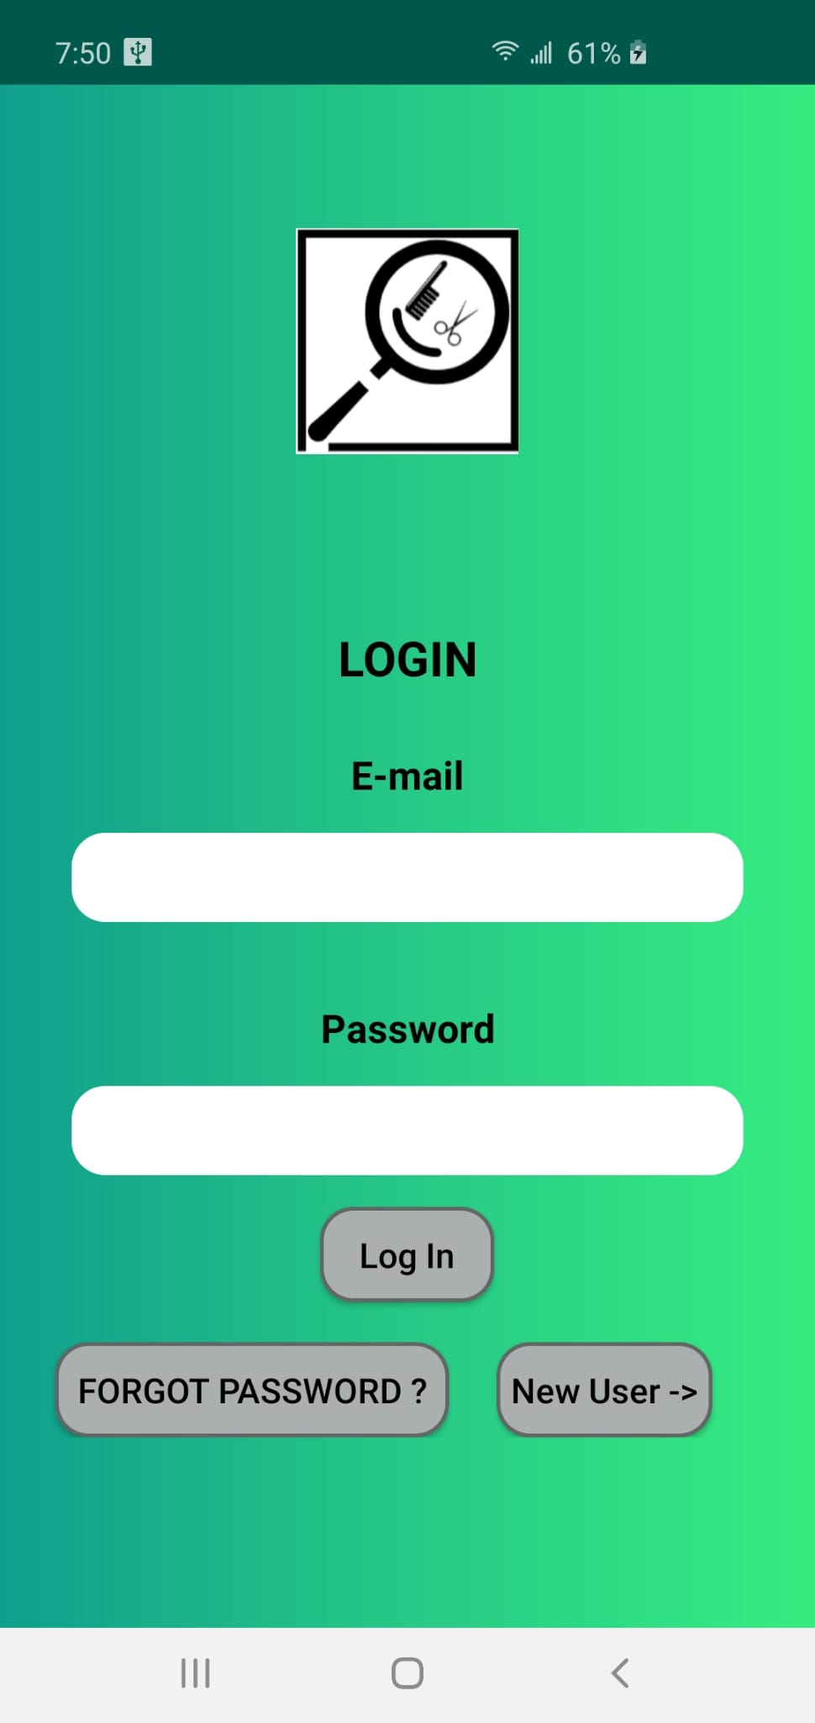
Login
Existing user can directly login
New user has to sign up
Forgot Password
Deepak Jayanthi

Slide 7
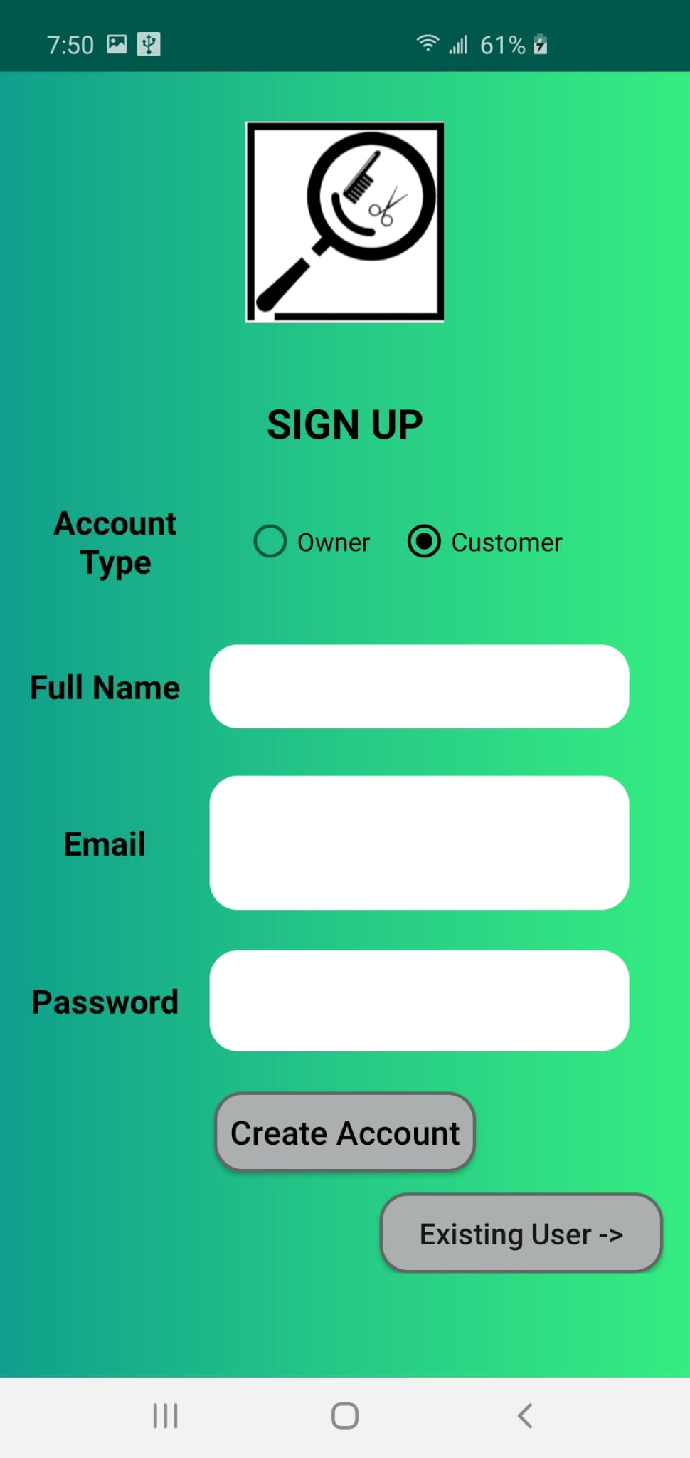
Customer Sign Up
Here new user can sign up as a customer by giving their full name, email address and password.
Existing user can directly login, user can be redirected to login page using “Existing user” button.
Deepak Jayanthi

Slide 8
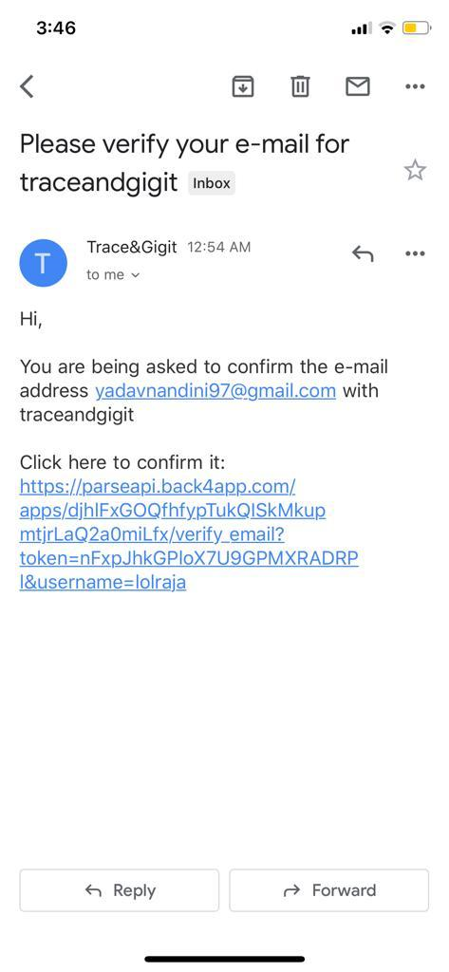
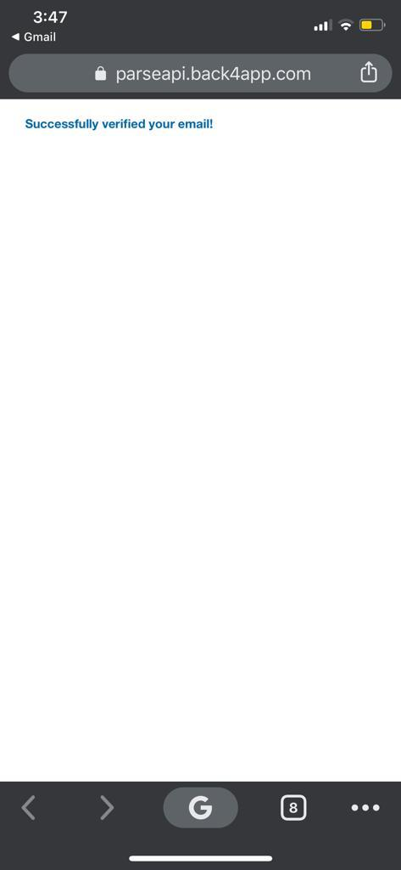
Email Verification
Email sent to mail address provided during Signup
Click on the provided link for verification.
On successful verification the email will be verified.
Deepak Jayanthi

Slide 9
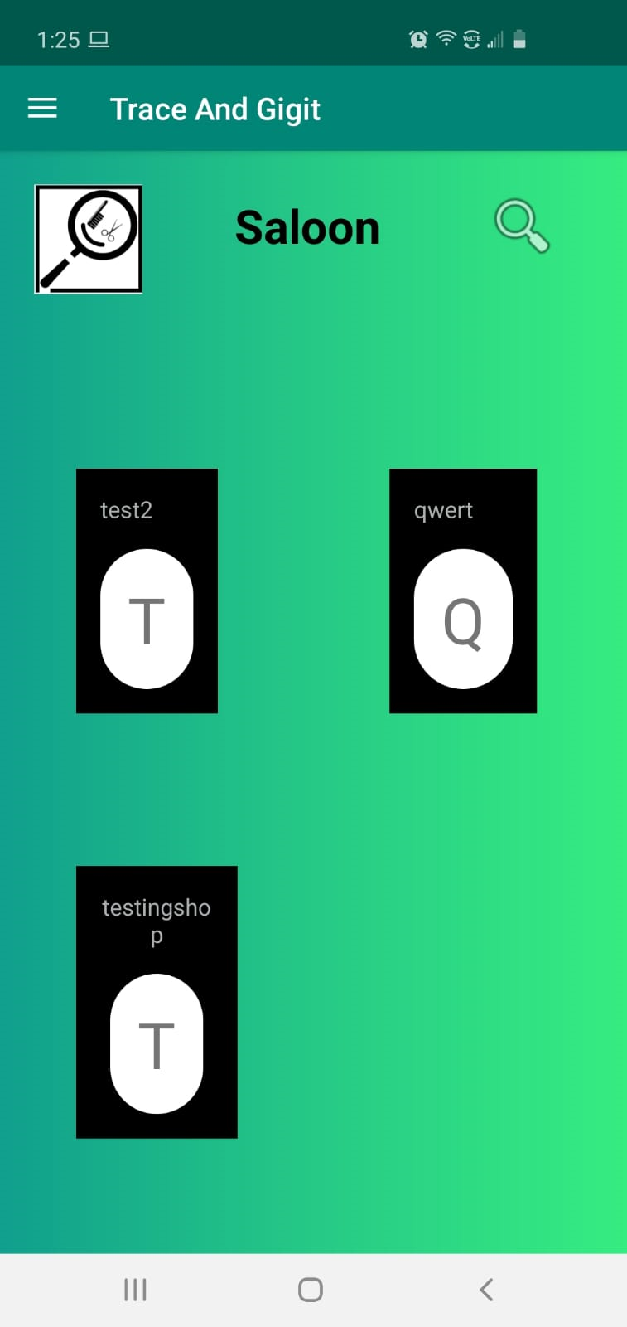
Customer Home Page
Nearby salons are shown
The salons shown are within the radius of 6 square miles.
Deepak Jayanthi

Slide 10
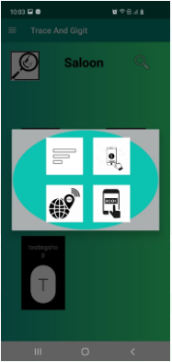
Salon Options
Menu
Payment
GPS
Booking
Bharadwaj Gandrakota

Slide 11
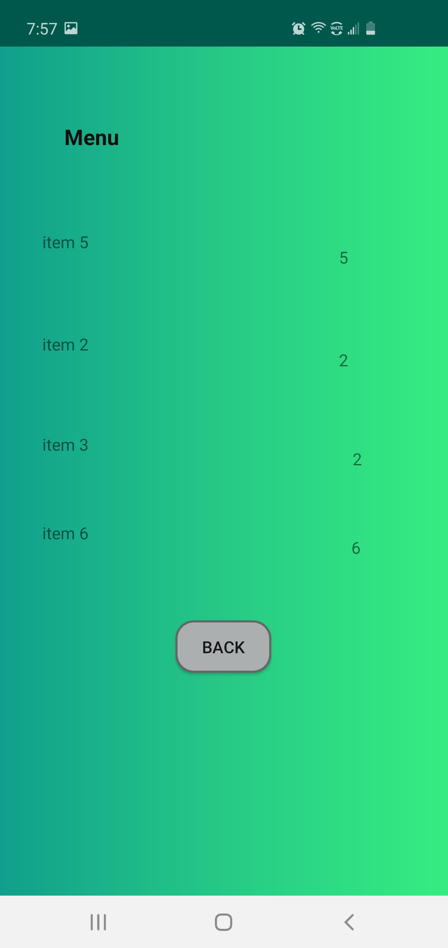
Menu
Salon services with the price are shown.
Based on that, user can select the style he want.
Bharadwaj Gandrakota

Slide 12
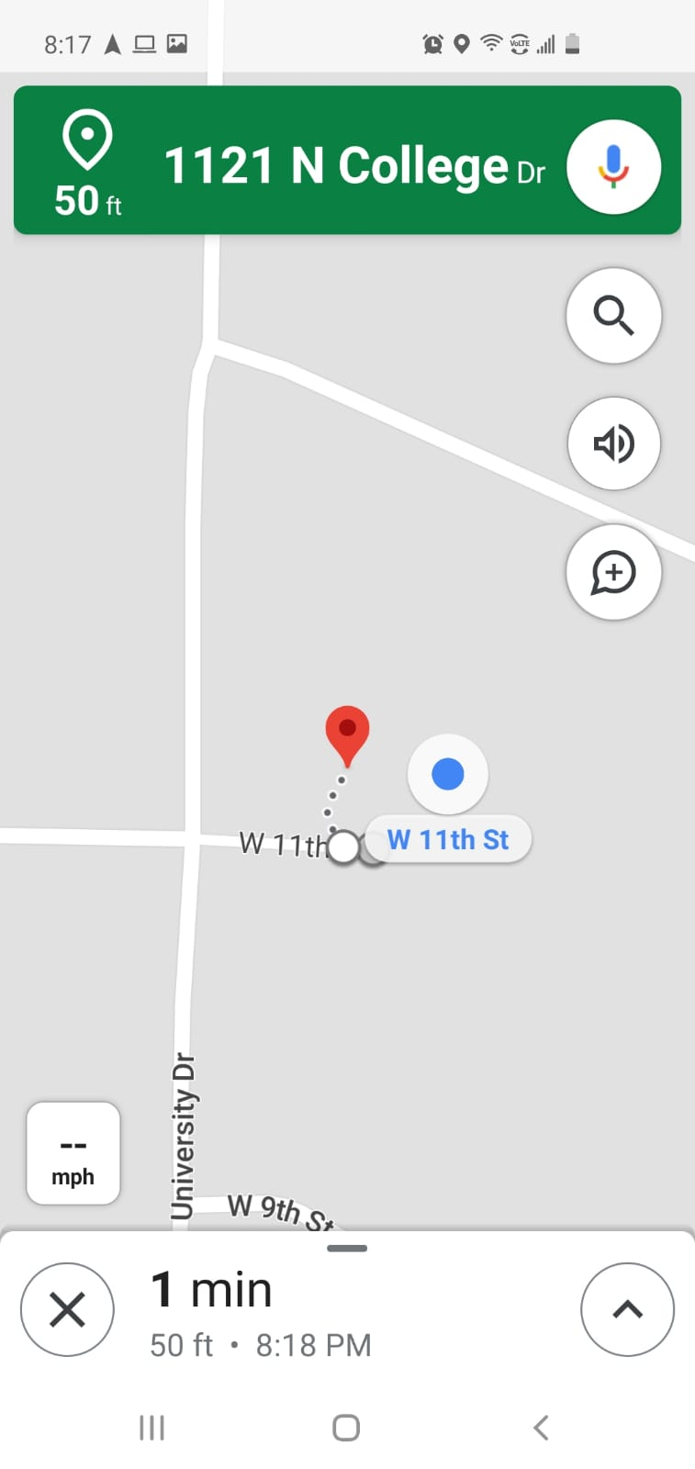
Map/GPS
GPS will take you to location of the salon
It will direct you to the location using google maps application
Bharadwaj Gandrakota

Slide 13

Book Appointment
By clicking on booking the appointment, request is sent to the owner
Once the appointment is accepted the slot is automatically booked
The notification is sent to customer and owner
Bharadwaj Gandrakota

Slide 14
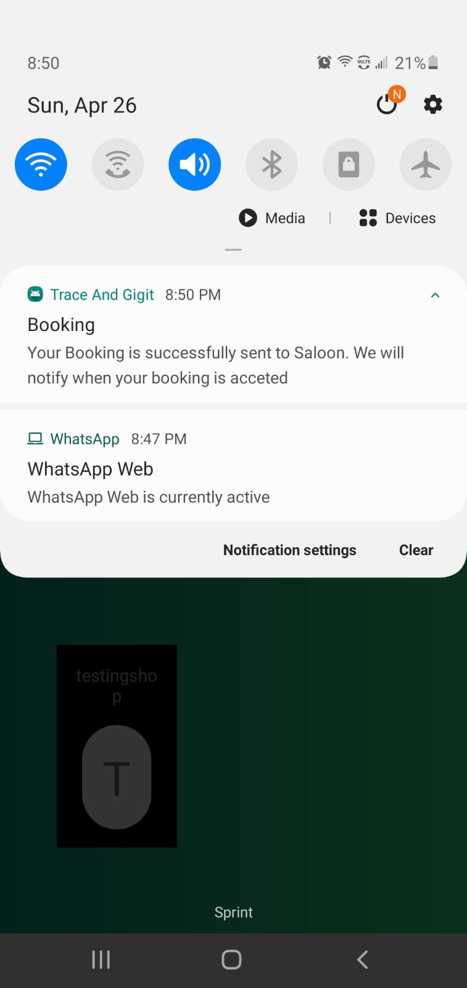
Customer Notification
Customer is notified as soon as he clicks on book appointment.
If the owner accepts the booking then notification is sent to user again saying that the request is accepted.
Nikitha Lakmarapu

Slide 15
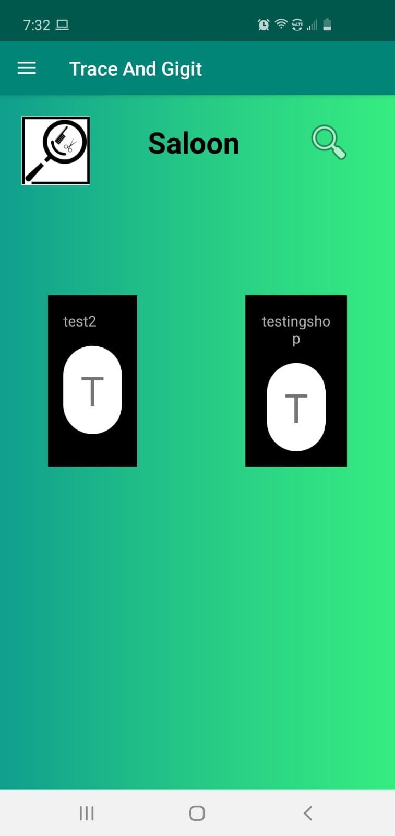
Search
By clicking on search symbol on the top it will give an edit text
By giving “tes” on the edit text and clicking on search symbol the resultant will be the salons that match with the given text in search bar
We can even book appointment from the search result
Nikitha Lakmarapu

Slide 16
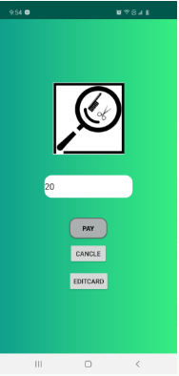
Payment
One can directly pay from the application after the booking.
If the card is added, we can directly pay without adding card each time you make the payment.
To add a new card, click on “EDIT CARD”.
Sowmya Kumbham

Slide 17
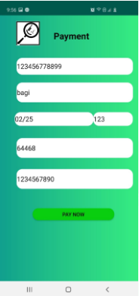
Add Card Details
Card can be added to the account just by entering few details.
It will be saved to your account.
Click on “PAY NOW” to make your payment.
Sowmya Kumbham

Slide 18
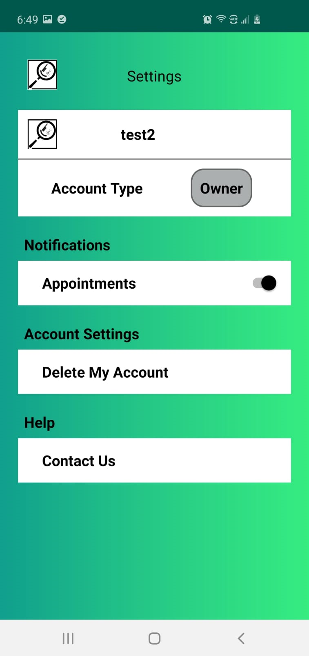
Settings
Settings screen is available for both customer and salon owner.
This is the settings of owner
Sowmya Kumbham

Slide 19
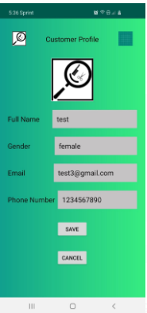
Customer Profile
Users can view or edit their profile anytime.
They can see their name, address, email id and phone number.
Email id given here will be used to send notifications. So, one can change their email id anytime.
Sowmya Kumbham

Slide 20
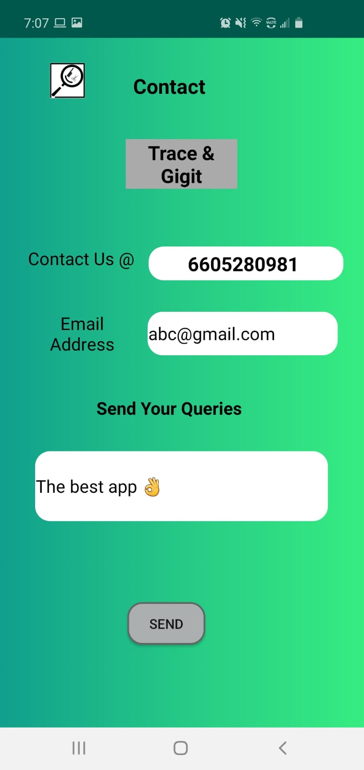
Contact
If a user has any problem he can contact the trace & gigit support team by just giving their email id and the query or problem
.
Sowmya Kumbham

Slide 21
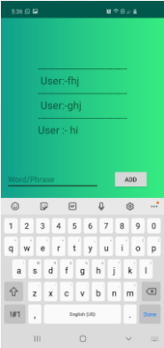
Live Chat
Trace & gigit team is available 24*7. So, users can contact support team any time through Live chat
We reply in less than 30 seconds
This facility is available for both customers and salon owners
It can be easily accessible from navigation menu
Nandini Yadav

Slide 22
Owner signup
Home page
Salon Profile
Menu Upload
Settings
Contact
Logout
Owner Functionalities
Nandini Yadav

Slide 23
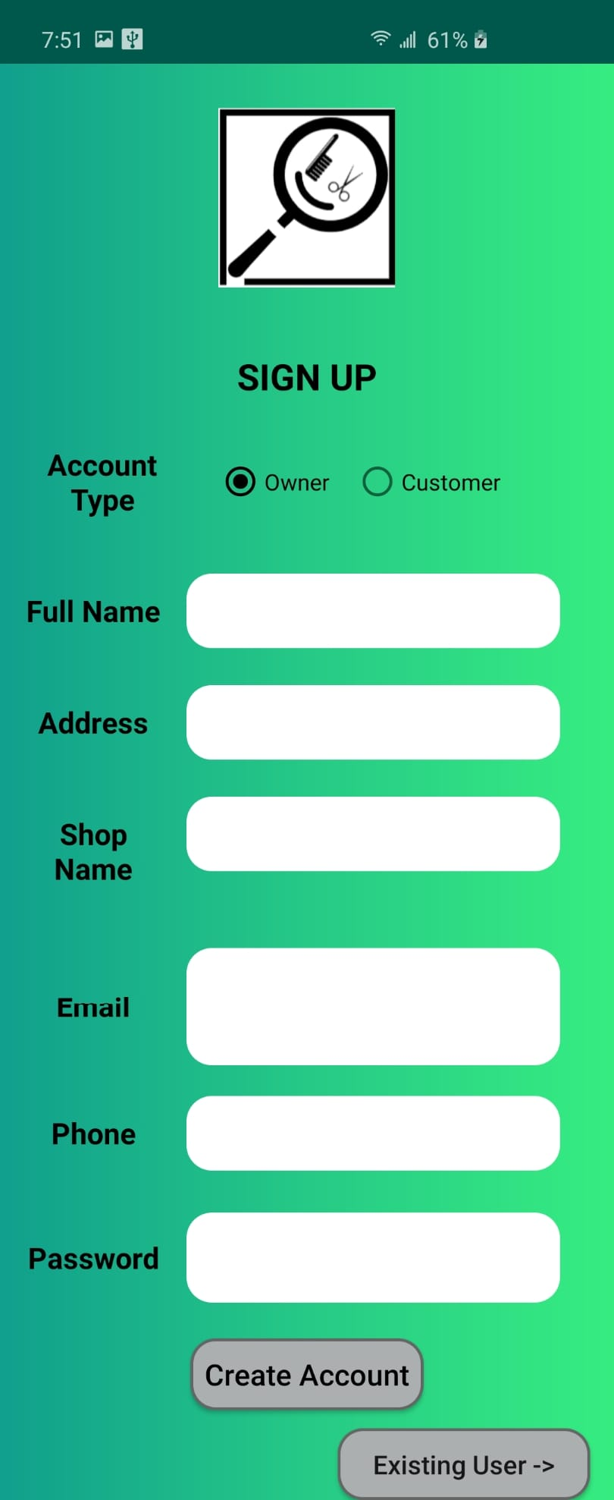
Owner Sign Up
Here new user can sign up as a owner by giving their full name, address, shop name, valid email address, phone number and password.
If the user is already existing, he will be redirected to login page using “Existing user” button.
Nandini Yadav

Slide 24
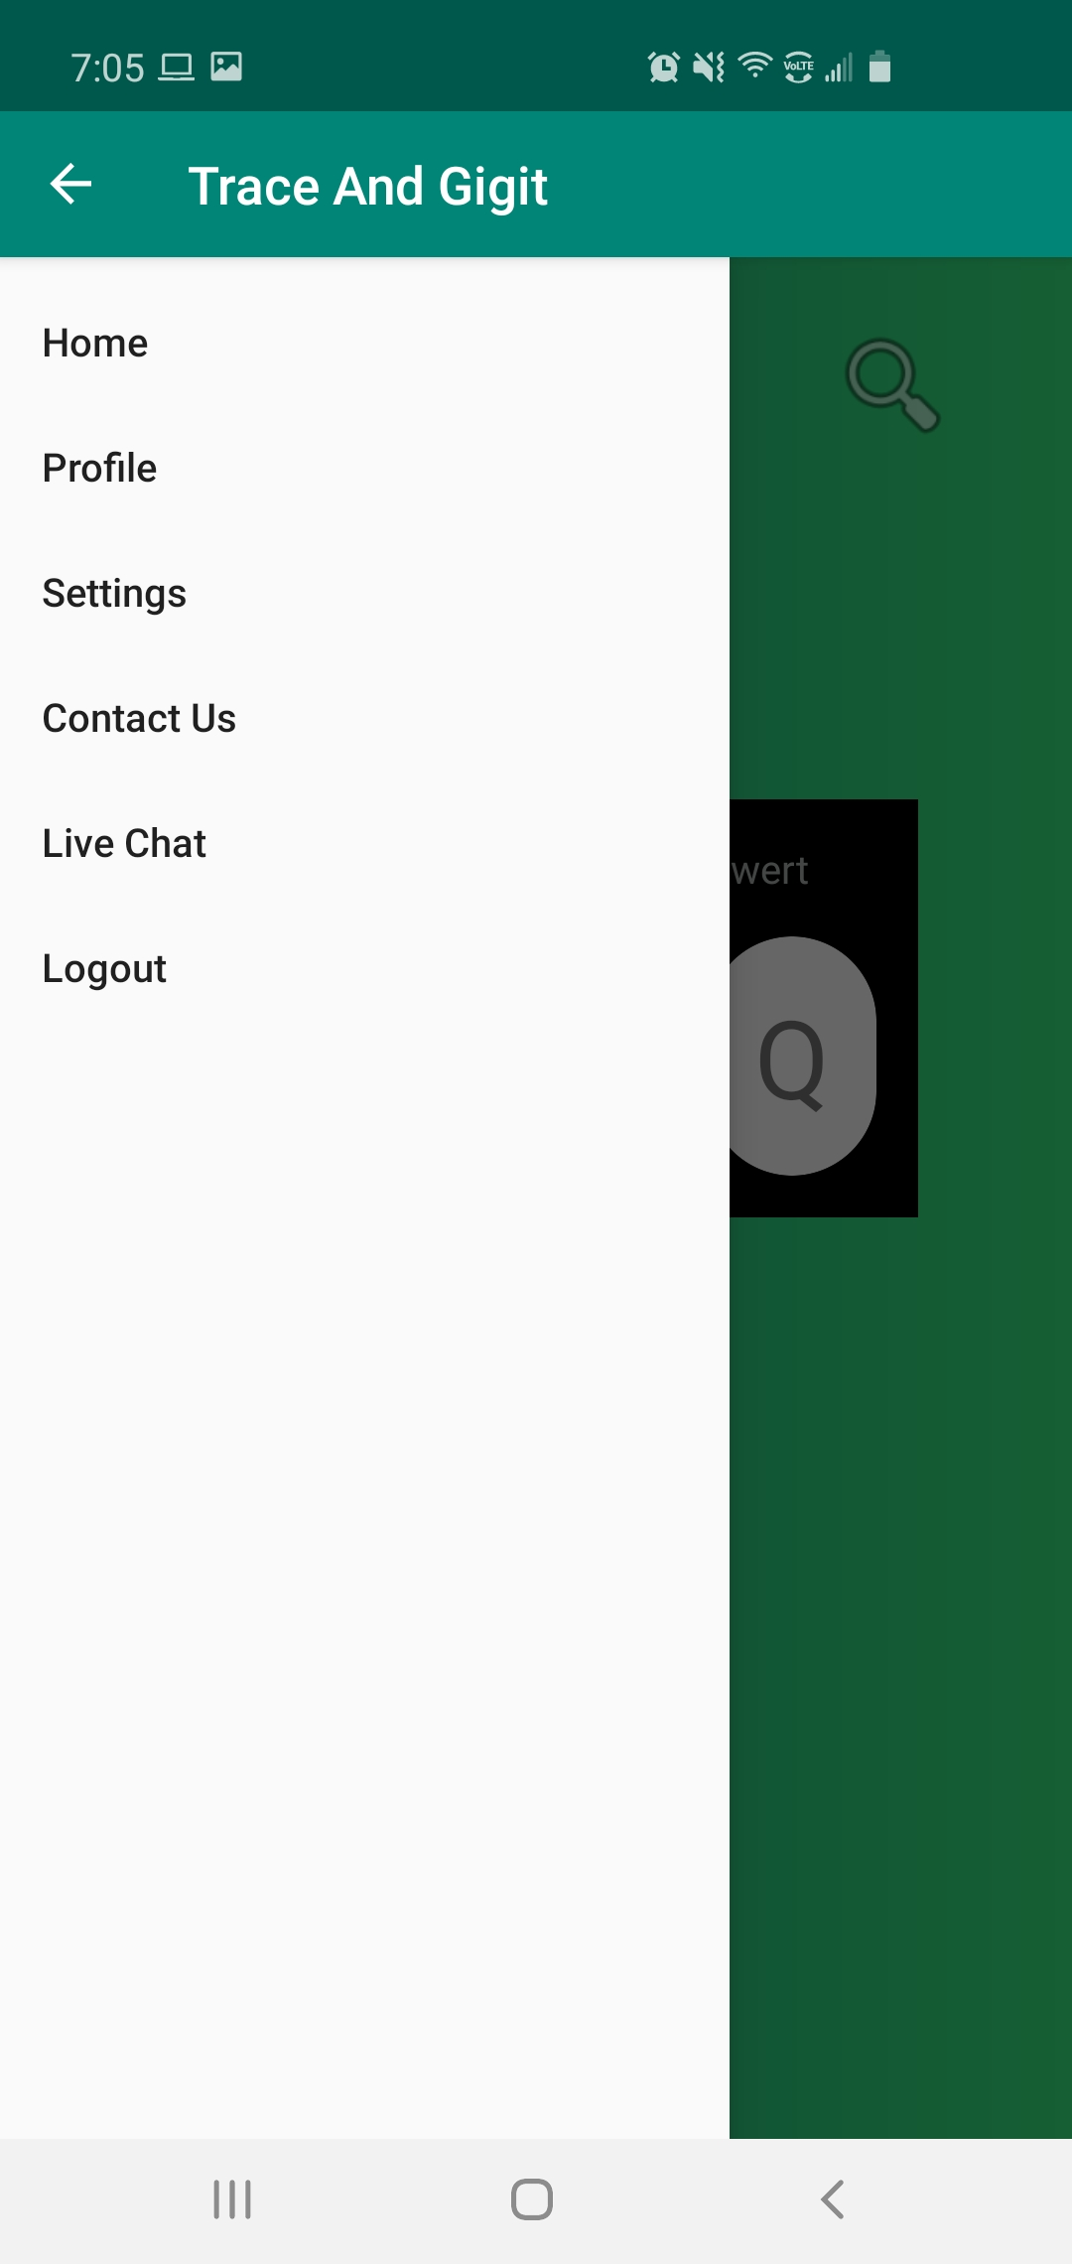
Navigation
Navigation is available for both customers and salon owners
Easy access through out the application
Nandini Yadav

Slide 25
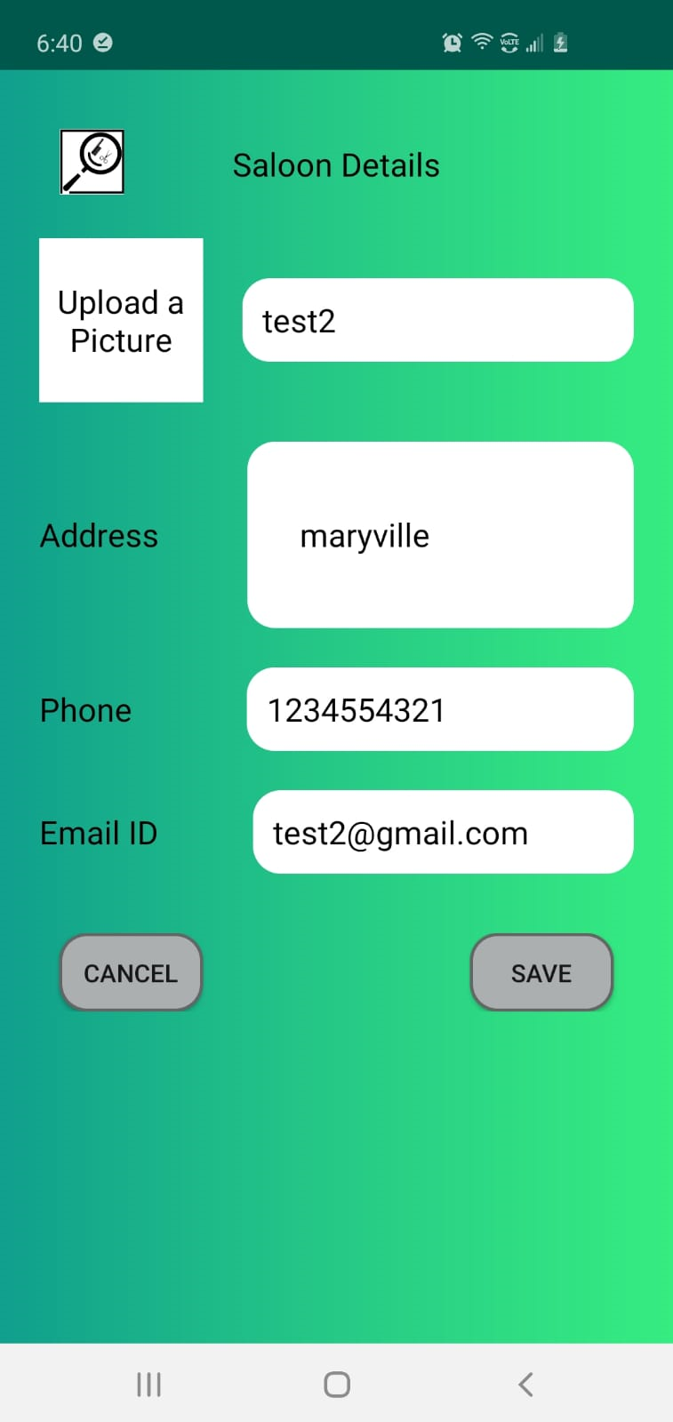
Add/Edit Salon Details
After Signup, owner will be prompted to add the Salon details like address, phone and email id
Cancel will not consider the edits made
Nandini Yadav

Slide 26
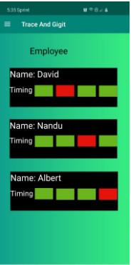
Owner Home Page
Employee schedule is to see available time slots of each employee
If they are occupied it shows red color else it shows green color
Based on that owner can allocate bookings to each employee
Leela Krishna

Slide 27
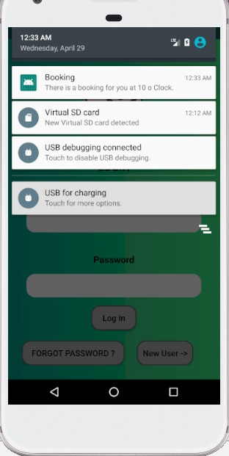
Owner Notifications
Once the customer books appointment, the owner gets notification of the appointment that is booked.
Owner can check the appointment by clicking on it and accept/reject appointment based on the timings of the employee.
Leela Krishna

Slide 28
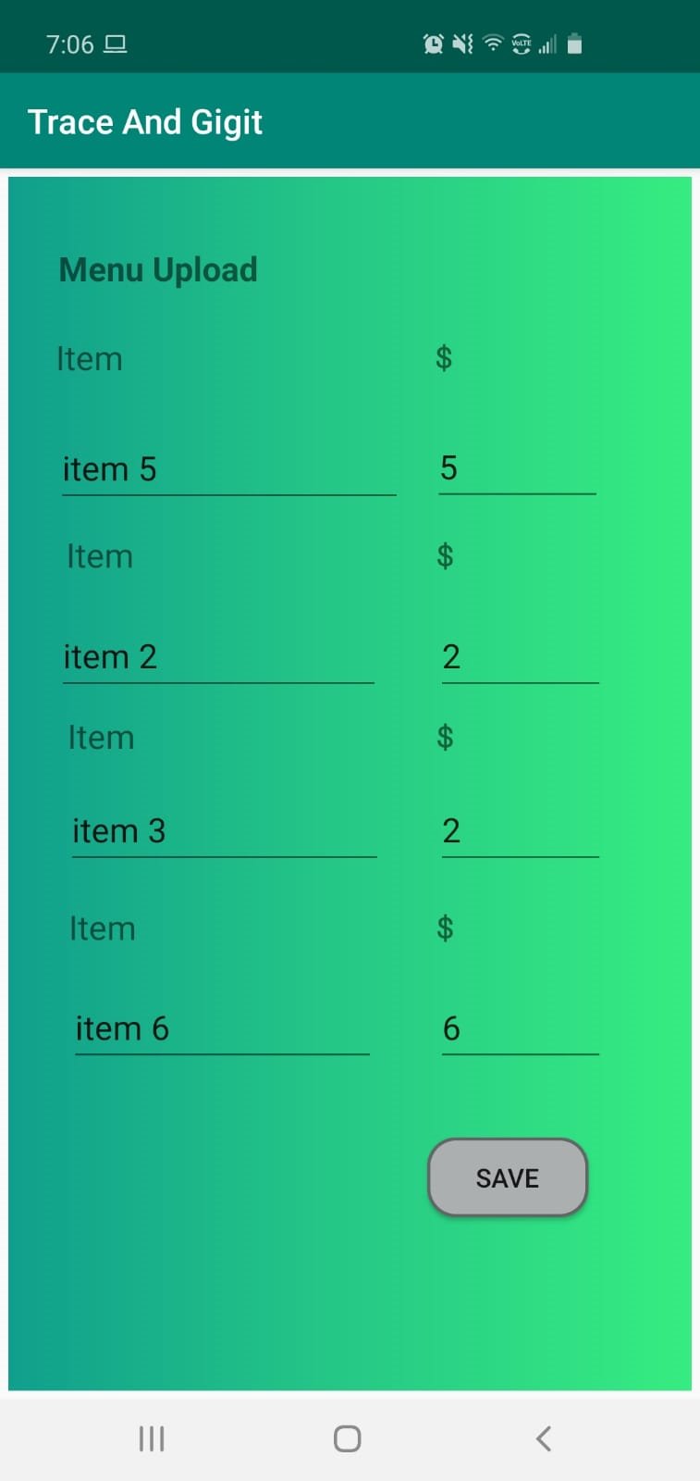
Menu Upload
Services provided at the salon can be updated through Menu Upload
Prices can be updated from time to time
Leela Krishna

Slide 29
DEMO
Team Trace & GigIt

Slide 30
Conclusion
We have successfully completed the application
Further, this can be extended more to book appointments at any service areas like hospitals, automobiles and other service based areas
Leela Krishna

Slide 31
References
https://squareup.com/us/en/appointments
https://www.raywenderlich.com/1214490-android-notifications-tutorial-getting-started

Slide 32

Thankyou

